Slide 1
SQL Project
By:
K C Kiran Sai Chandan
(Data Analyst Trainee At Besant technologies BTM Layout,Bangolore)
Trainee Name:
Mr.Kavibharathi

Slide 2
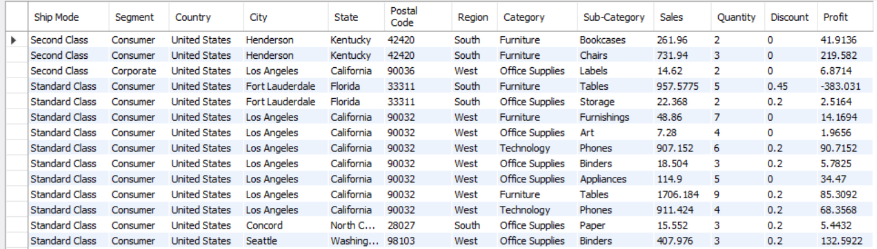
1. Querry to display all details of super store.
SELECT *
FROM superstore;

Slide 3
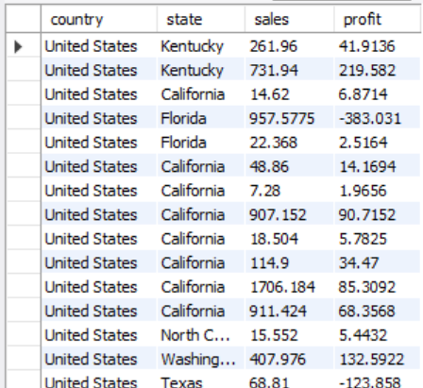
2. Query to Dispaly country and states with it's sales and profit.
SELECT country,state,sales,profit
FROM superstore;

Slide 4
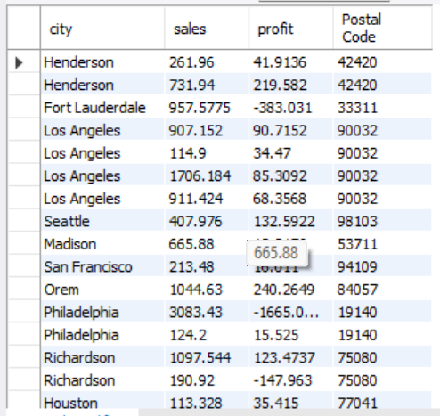
3. Querry to dispaly city name, Postal Code, sales, profit where sales are greater than 100.
SELECT city,sales,profit,`Postal Code`
FROM superstore
WHERE sales > 100;

Slide 5
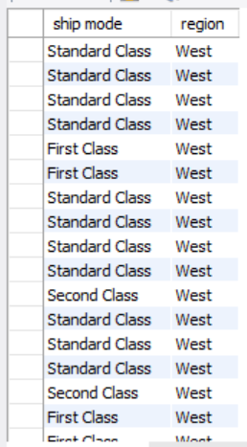
4. Querry To Dispaly ship mode in west region.
SELECT `ship mode`,region
FROM superstore
WHERE region='west';

Slide 6
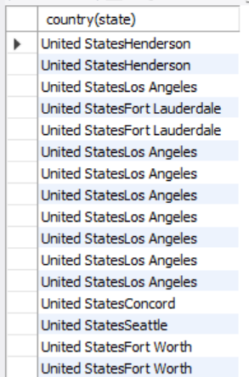
5. Querry to Dispaly Country and City of Segemnt in single output console.
SELECT concat(country,city) as 'country(state)’
FROM superstore;

Slide 7
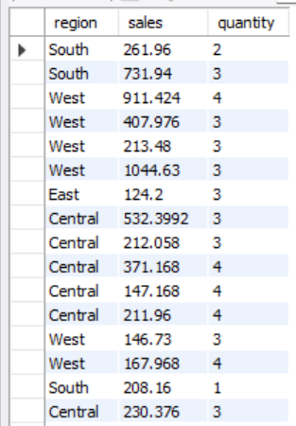
6. Querry to Dispaly region of sales are more than 100 and quantity lessthan 5.
SELECT region, sales, quantity
FROM superstore
WHERE sales>100
AND quantity<5;

Slide 8
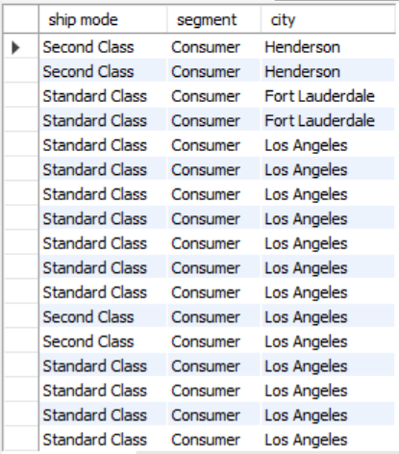
7.Querry to Dispaly ship mode where segment was consumer in city henderson,
fort lauderdale,los angeles and Richardson.
SELECT `ship mode`,segment,city
FROM superstore
WHERE segment IN ('consumer') AND
city IN ('henderson','fort lauderdale','los angeles','richardson');

Slide 9
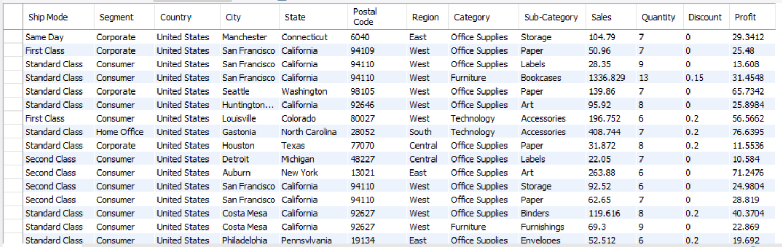
8.Querry to Dispaly Details of store where profit Between 10 to 100 and quantity was not betweeen 0 to 5.
SELECT * FROM superstore
WHERE profit BETWEEN ‘10’ AND ‘100’
AND quantity NOT BETWEEN ‘0’ AND ‘5’ ;

Slide 10
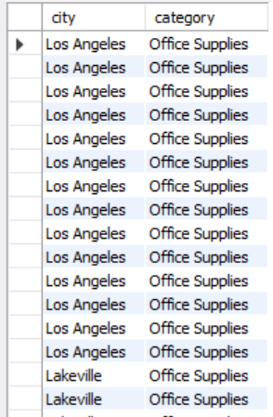
9. Querry to Dispaly city name starts with “l” and category was ends with “s”.
SELECT city,category
FROM superstore
WHERE city LIKE ‘l%’ AND
category LIKE ‘%s’ ;

Slide 11
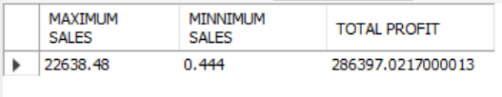
10. Querry to Dispaly Maximum and Minimum sales and sum of profit .
SELECT MAX(sales) AS ‘MAXIMUM SALES’,
MIN(sales) AS ‘MINIMUM SALES’,
SUM(profit) AS ‘TOTAL PROFIT’
FROM superstore ;

Slide 12

11. Querry to Dispaly average of profit and count of sales.
SELECT AVG(profit),
COUNT(sales)
FROM superstore;

Slide 13

12.Querry to Dispaly count of category and sub category with total profit.
SELECT COUNT(CATEGORY) AS ‘TOTAL CATEGORIES’,
COUNT(`sub-category`) AS ‘TOTAL CATEGORIES’,
SUM(profit) AS ‘TOTAL PROFIT’
FROM superstore ;

Slide 14
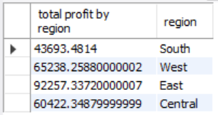
13. Querry To Dispaly Profit In Each Region.
SELECT SUM(profit) as ‘total profit by region’,
Region FROM superstore
WHERE Profit > 150
GROUP BY region ;

Slide 15
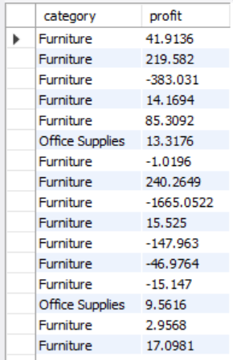
14. Querry to Dispaly category of profit in office supplies,furniture.
SELECT category, profit
FROM superstore
WHERE profit in
(SELECT profit
FROM superstore
WHERE category in ('office supplie','furniture’));

Slide 16
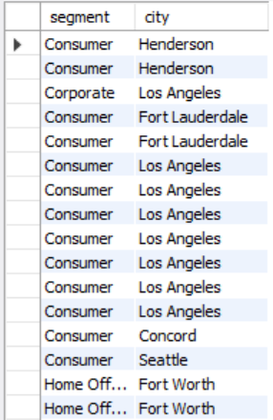
15. Querry to Dispaly segment of state in south region.
SELECT segment,city
FROM superstore
WHERE segment in
(SELECT segment
FROM superstore
WHERE region = ‘south’) ;

Slide 17

16. Querry to Dispaly Avarage sales by country.
SELECT country,AVG(sales)
FROM superstore
GROUP BY country ;

Slide 18
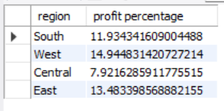
17. Querry to Dispaly profit percentage by region.
SELECT region,(sum(profit)/sum(sales)*100) as ‘profit percentage’
FROM superstore
GROUP BY region ;

Slide 19
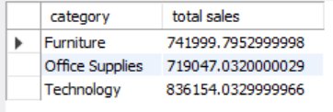
18. Querry to Dispaly sales more than 100 based on category.
SELECT category,SUM(sales) as 'total sales’
FROM superstore
GROUP BY category ;

Slide 20
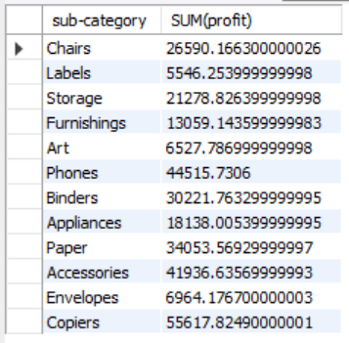
19.Querry to Dispaly average profit more than 5000 bases on sub category.
SELECT `sub-category`,SUM(profit)
FROM superstore
GROUP BY `sub-category`
having (sum(profit) > 5000) ;

Slide 21
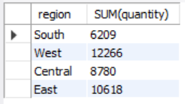
20.Querry to Dispaly quantity based on region where.
SELECT region,SUM(quantity)
FROM superstore
GROUP BY region ;

Slide 22
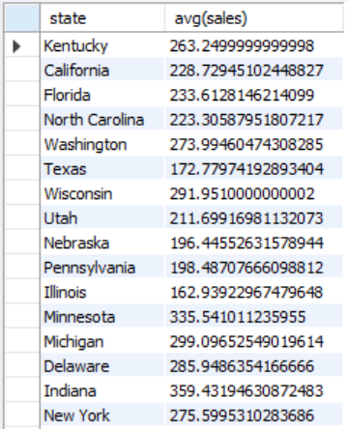
21. Querry to Dispaly states with it's average sales.
SELECT state,avg(sales)
FROM superstore
GROUP BY state ;

Slide 23

22. Querry to Dispaly country with its average profit.
SELECT country,AVG(profit)
FROM superstore
GROUP BY country ;

Slide 24
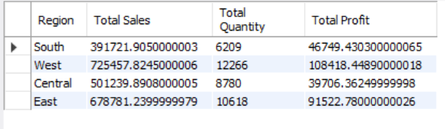
23.Query to dipalay details sum of sales,quantity,profit in different regions.
SELECT Region,SUM(sales) as 'Total Sales’,
SUM(quantity) as 'Total Quantity’,
SUM(profit) as 'Total Profit’
FROM superstore
GROUP BY Region ;

Slide 25
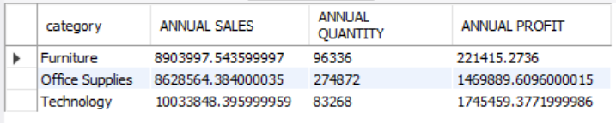
24. Query to display sum of sales,quantity,profit for one year in different categories.
SELECT category,(SUM(SALES)*12) AS ‘ANNUAL SALES’,
(SUM(QUANTITY)*12) AS ‘ANNUAL QUANTITY’,
(SUM(PROFIT)*12) AS ‘ANNUAL PROFIT’
FROM superstore
GROUP BY Category ;

Slide 26
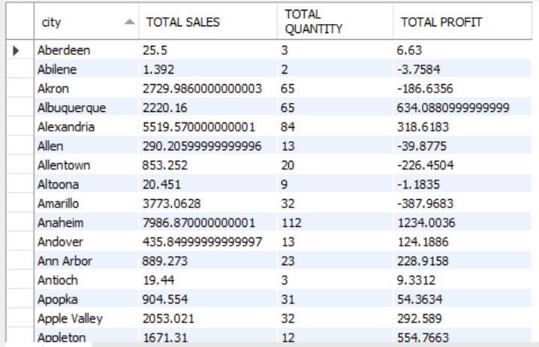
25.Query to display city with total sales,quntity,profit.
SELECT city,SUM(sales) as ‘TOTAL SALES’,
SUM(quantity) AS ‘TOTAL QUANTITY’,
SUM(profit) AS ‘TOTAL PROFIT’
FROM superstore
GROUP BY city ;

